Slide 1
Cost-Benefit Analysis – Strengthening the Evidence for Policy Decisions in Nigeria
(Training Manual)
by
A. A. A. Coker (PhD), Federal University of Technology, Minna, Niger State
&
B. A. Sule (PhD), Ibrahim Badamasi Babangida University, Lapai, Niger State
Makurdi Luxury Suites. Judges Quarter, February 14, 2022

Slide 2
Training Outline
Module 1: Overview of Cost-Benefit Analysis
Module 2: Introduction to Farm Budgets, Farm Income Analysis, Project Analysis and Financial CBA
Module 3: Discounting Costs and Benefits in Future Time Periods
Module 4: Model Farm Budgets and Aggregation to Project Level Budget
Module 5: Discounted Measures of Project Worth
Module 6 :Risk Analysis in CBA
Module 7: Economic Cost-Benefit Analysis
Module 8: Applications of CBA to Policy Analysis

Slide 3
Training Goal
To equip and enhance participants’ understanding of the application of CBA techniques for Agricultural policy, programme and project analysis.

Slide 4
Training Objectives
At the close of this training, participants will be able to:
understand the basic concepts of CBA;
develop and analyze enterprise budgets;
acquire relevant skills to conduct financial and economic analysis of agricultural programmes and projects;
carry out risk analysis for agricultural programmes and projects; and
select among project alternatives to support policy decisions.

Slide 5
MODULE 1 Overview of Cost-Benefit Analysis
1.0 INTRODUCTION
Policy makers and private actors face difficulties in allocating scarce resources across projects and programmes.
In Nigeria, colossal resources have been allocated to the Agriculture sector without commensurate results.
CBA provides the framework and relevant information for taking decisions, by ascertaining to what extent the benefits from an intervention exceed the costs of its implementation (Robinson and Hammitt, 2013)
CBA dwells on how outcomes (positive or negative) are distributed across project participants or members of the society.

Slide 6
1.1 Meaning of Cost-Benefit Analysis (CBA)
CBA is an analytical tool that applies a systematic process for calculating and comparing benefits and costs of investments
CBA involves identifying, measuring, and comparing monetary costs and benefits of an investment programme or project (Campbell and Brown, 2016)
A Cost is anything that reduces or takes away from your objectives
Benefits increases or contributes to your objectives (Gittinger, 1984).

Slide 7
1.2 Purpose of CBA
Improves project design
Informs project selection
Justifies project to stakeholders and development agencies
Prevents or minimizes waste of scarce resources
Shows the superior efficiency of a particular intervention relative to other alternatives, including the status quo (Boardman et al., 2018)

Slide 8
1.3 Scope of CBA
CBA is applicable to agricultural policies, programmes, projects, regulations, and other government interventions (Boardman et al., 2018)
It is also being deployed for market and non-market valuations of benefits and costs

Slide 9
1.4 Types of CBA
Ex ante. useful for deciding whether resources should be allocated to a programme or project under consideration
In medias res. refers to the analysis of an on-going project. Useful for decision making purposes where it is potentially feasible to subject resources to alternative uses
Ex post. Undertaken at the close of the project. Excellent in learning about the actual value of similar projects (Boardman et al. ,2018)

Slide 10
Table 1.1: Benefits of different CBAs
Benefits/Value | Ex- Ante | In Medias Res | Ex-post
Resource allocation decision for project | Yes, helps to select best project or make “go” versus “no-go” decision if accurate | If low sunk cost, can still shift resources. If high sunk cost, usually recommends continuation | Too late. The project is over.
Learning about actual value of specific project | Poor estimate, High uncertainty about future costs and benefits | Better, Reduced uncertainty | Excellent. Although some errors may remain. May have to wait long for study
Contributing to learning about actual value of similar projects | Unlikely to add much | Good. Contribution increases as performed later. Need to adjust for uniqueness | Very useful although there may be some errors and need to adjust for uniqueness
Learning about omission, forecasting, measurement, and evaluation errors in CBA | No | No | No
Source: Boardman et al. (2018)

Slide 11
1.5 Steps in Conducting CBAs
Step 1: Specify the set of alternative projects
Minimize alternatives to manageable numbers
Specify the “with” and “without” project scenario by identifying the counterfactual
The displaced project or project not receiving intervention is called the “counterfactual”
Counterfactual measures what would have happened to the beneficiaries in the absence of intervention
All counterfactuals starts in year 1 with the status quo
Impact is estimated by comparing counterfactual outcomes to those observed under intervention.

Slide 12
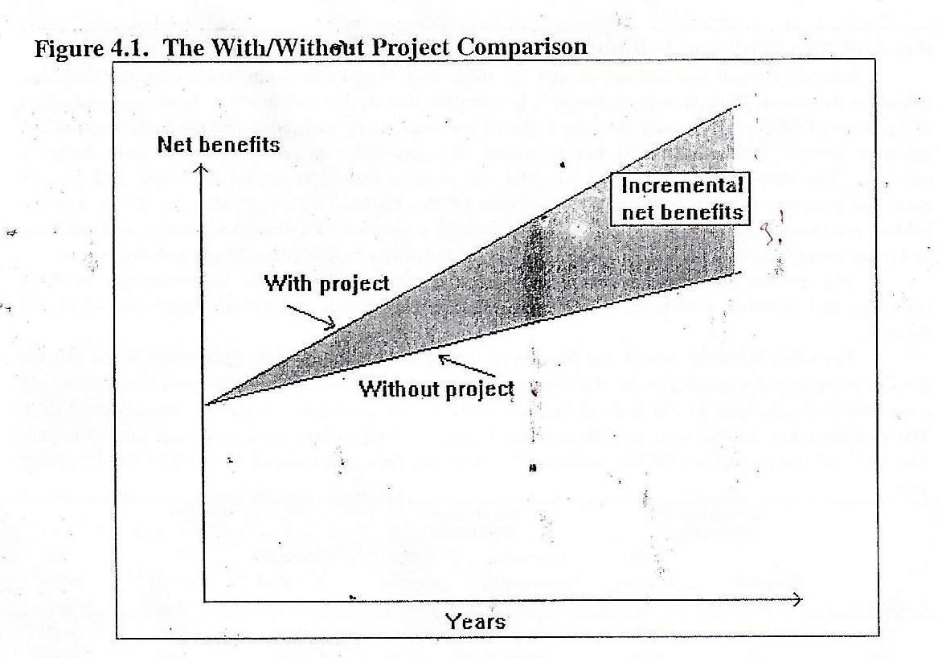
Figure 1: The With/Without Project Comparison
The with /without comparison measures the incremental benefits arising from the project
It differs from before /after comparison which fails to account for changes without project
For example - If production without project were to increase at 3% per year and with project at 5% per year
Project contribution will be an increase of 2% per year (Figure 1).

Slide 13
1.5 Steps in Conducting CBAs (CONT’D)
Step 2: Decide on whose benefits and costs count (standing)
Must decide whose benefits and costs should be included or considered in the analysis
Be clear on the perspective for which the analysis is to be based: the individual or community
Individual perspective affects the individual, group, cooperative, firm, etc.
Community perspective affects everyone irrespective of where they reside (this could be LGA, State, Country or Global) .

Slide 14
1.5 Steps in Conducting CBAs (CONT’D)
Step 3: Identify and catalogue the impact categories and select measurement indicators (Figure 2)
Figure 2: Impact categories
Impact
Benefits
Costs
Increase in output –e.g. crop, livestock, and fish
Increase in food security and nutrition;
Improved skills or better education
Increase in employment;
+ve externalities such as improvement in environmental quality;
Time saving due to new technology;
Provision of infrastructure;
Cost reduction or losses avoided, etc.
Agricultural inputs – e.g. land, labour, fertilizer, and agrochemicals
Construction costs
Equipment such as farm machinery and tools
Consultancy fees
Negative externalities e.g. pollution
Increase in morbidity and mortality
Benefits that are lost, etc.

Slide 15
1.5 Steps in Conducting CBAs (CONT’D)
Step 4: Predict the impact quantitatively over the lifespan of the project.
Examples include:
Yield of rice;
Fish output;
Quantity of fertilizer used;
Number of fingerlings;
With these values. One can estimate:
Cost of fertilizer used on rice farm;
Total cost of fingerlings used;
Total revenue from rice farm per hectare;
Total revenue from fishery enterprise; etc.

Slide 16
1.5 Steps in Conducting CBAs (CONT’D)
Step 5: Monetize (Attach monetary value) to all impacts
Monetize each of the impacts, in other words, attach monetary value to the impacts
E.g. Value of fertilizer used = 8 bags of 50kg each
Price of 50kg fertilizer (1 Bag) = ₦8,000.00
Total value of fertilizer used = 8 × 8,000.00
= ₦64,000.00

Slide 17
1.5 Steps in Conducting CBAs (CONT’D)
Step 6: Discount benefits and costs to obtain present value
Aggregate benefits and costs that arise in different years
Discount future benefits and costs to obtain their present values (PV)
Reason for discounting include:
Opportunity cost to the resources used in a project
Human preference for consumption now than later
NOTE: Discounting has nothing to do with inflation however, inflation can be used in determining the future value of money

Slide 18
1.5 Steps in Conducting CBAs (CONT’D)
Inflation
Inflation occurs when the nominal prices of goods and services rise over time
Inflation raises concern as to whether project inputs and outputs should be measured in:
prices at the time of appraisal - today’s prices (Constant prices),
Prices in force in future when project inputs or outputs occur (current or nominal prices) or
Real prices
Which is the better approach?
It has been shown that when the prices of commodities inflate at same rate, the three approaches give more or less same result, though, not in all instances.
Note: When inflation is not included in the analysis, the real rate of interest must be used as the discount factor (Campbell and Brown, 2016; p.36).

Slide 19
1.5 Steps in Conducting CBAs (CONT’D)
Derivation of real rate of interest:
The real interest rate is presented in Equation 1.
r = i-m/1+m (1)
Where: r = real interest rate;
i = nominal interest rate and
m = rate of inflation
Example:
If i= 26%; m=16%, then,
r = 0.26-0.16/1+0.16
= 0.086 or 8.6%

Slide 20
1.5 Steps in Conducting CBAs (CONT’D)
Step 7: Compute the net present value of each alternative
The Net Present Value (NPV) of an alternative equals the difference between the PV of the benefit and the PV of the cost
Step 8: Perform sensitivity analysis
Considerable uncertainty exists with respect to the following:
Prediction and valuation of benefits and costs;
Choice of discount rate;
Appropriate level of standing, etc.;
Sensitivity analysis deals with varied categories of uncertainties
There are limits to the magnitude of sensitivity analysis
Use judgement and focus on the most important assumptions

Slide 21
1.5 Steps in Conducting CBAs (CONT’D)
Step 9: Make recommendations
Recommend adoption of a project based on the following viability indicators:
Incremental Benefits;
Benefit-Cost Ratio;
Net Present Value; and
Internal Rate of Return

Slide 22
1.6 Limitations of CBA
Technical limitations (data and analytical resources) make it difficult to quantify and monetize all relevant impacts as costs and benefits
Only when all costs and benefits are expressed in monetary terms can potential Pareto principle be applied, or calculation of net benefit done
Goals other than efficiency are relevant to policy makers

Slide 23
1.7 Cost-Effectiveness Analysis (CEA)
Cost-effectiveness analysis (CEA) is an alternative to cost-benefit analysis (CBA)
CEA is aimed at determining the cost of achieving a specific target.
CEA makes it possible to quantify impacts without necessarily monetizing them
It is handy when one is unable or unwilling to monetize major benefits
A ratio can be constructed involving the quantitative but non monetized items
Allows for policies and projects’ selection, in terms of cost effectiveness criterion

Slide 24
MODULE 2 Introduction to Enterprise Budget and Financial CBA
2.1 Farm (Enterprise) Budget:
A budget is a plan to coordinate the inflows and outflows of resources to achieve a given set of objectives (Brown, 1982),
Enterprise budgeting is concerned with organizing resources to maximize profits or, more often, for family satisfaction,
Budget management analyses are prepared primarily to evaluate the efficiency of a particular farm or a group of farms within an accounting period,
In project analysis, budget provide the basis for evaluating and comparing the relative profitability of alternative investments,
It may involve a single enterprise or group of enterprises (described as the project area).

Slide 25
2.2 Farm Income and Project Analysis
Enterprise budget involves investment in packages of inputs and from which a flow of benefit and cost is projected over a specific period
Farm Income Analysis reflects the efficiency and profitability of the project on an annual basis
Agricultural Project Analysis uses the annual differences between benefits and costs to calculate an index of profitability of the project over its entire life

Slide 26
2.2 Farm Income and Project Analysis (continues…)
Figure 3: Farm Income and Project Analysis

Slide 27
2.3 Data Requirements for Building Farm (Enterprise) Budgets
Components necessary for building a farm (enterprise) budget, include:
Fixed and variable costs;
Labour and materials;
Farm input costs (Fertilizer, agrochemicals, etc);
Equipment and space;
Taxes, indirect cost, etc
Output, revenue
These enable estimates of enterprise performance using gross margin, profit, etc.

Slide 28
2.4: Financial or Private CBA
2.4.1 Background
This refers to Cost-benefit analysis from the perspective of individuals, groups, firms, and enterprises
It deals with costs and benefits of the project that accrue to the enterprise itself and affects its profitability (Campbell and Brown, 2016)
It aims at assessing the financial effect of the project on the project participants, such as; farmers, other value chain actors, private firms, public corporations, and project agencies
Financial analysis is the basis for working out the budget and other requirements of a project
For each of the actors, separate budgets must be prepared to ascertain financial profitability and viability

Slide 29
2.5: Objectives of Financial Analysis
Primary objective
To determine the returns to participants of the project or intervention
Secondary objectives. These are to:
assess financial efficiency and sustainability of project intervention;
determine project incentives to participants;
ascertain credit worthiness, liquidity of enterprise, and debt repayment;
determine the investment and operating requirement for project;
identify need for equipment replacement; and
determine ways of financing the project.

Slide 30
2.6 Procedures for Financial Analysis
The analysis should have a clear-cut objective such as maximization of income or efficiency
Clearly specify the “with project” and “without Project” scenarios and determine the project lifespan
Project lifespan is usually tied to the technical or economic life of the intervention (15 to 25 years is globally accepted for development projects).
For Agricultural interventions such as livestock, fisheries, and agro-forestry, projection of area, yield, production, and consumption of output should follow logically.
For crop-based projects, determine the cropping pattern before project intervention activities (without) and the new cropping pattern.
NOTE:
Sourcing all the required information to efficiently carry out a CBA normally requires a multi-disciplinary team of experts, including an economist

Slide 31
2.7 Procedures for Financial Analysis
v. Determine the ‘with’ project situation to estimate the benefit(s) of the project, following which an investment pattern is proposed based on criteria such as:
Farmer’s wishes and aspirations;
Marketing aspects (consumer and/or industrial);
Government regulations;
Crop water requirement;
Rotational consideration;
Access to inputs;
Financial consideration;
Labour requirement, etc.

Slide 32
2.8 Procedures for Financial Analysis
vi. This is followed by the derivation of the cash flow for each enterprise promoted by the project.
vii. The incremental net benefits should be estimated for each enterprise (that is, the difference between the benefits from the 'with' and 'without’ project scenarios).
viii. The incremental net benefits obtained for the average beneficiary are then summed up to obtain the flow of incremental net benefits for the projected number of project participants.
ix. Financial Internal Rate of Return (FIRR) and Financial Net Present Value (NPV) are then estimated for all project beneficiaries, either manually or using excel or other analytical packages.

Slide 33
MODULE 3 Discounting Benefits and Costs in Future Time (Periods)
3.1 Time Value of Money
Time value of money is an important component in CBA due to the following reasons:
Inflation;
Interest earned over a period;
difference in purchasing power over time;
Opportunity cost to earn interest on money; and
Preference of current to future consumption.

Slide 34
3.1.1 Future Value of Money (Compounding)
Shows the amount a sum of money grows into over the years at varying interest rates
It entails predicting accumulated future costs
It is specified or derived as detailed in the Equation 2:
${FV=PV (1+i)}^{n}$ (2)
Where: FV = Future value; i = Interest per period;
PV = Present value; n= Number of periods; and
1 = Constant

Slide 35
Exercise 1:
Calculate the amount receivable if a fish farmer invests ₦10,000.00 in his/her fishery enterprise for 10years at 9%.
Solution:
FV = PV (1 + $i$)^{n}
Where:
FV = Unknown, PV = ₦10,000.00,
i = 9% (0.09), n = 10years,
FV = 10,000 (1 + 0.09)¹⁰
= ₦23,673.64

Slide 36
3.1.2 Present Value of Money (Discounting)
Premised on popular adage “a bird in hand is worth two in the bush”.
Value of Naira now is worth more than a Naira in a future date
A technique for reducing future costs and benefits to their present worth
The present value model is specified in Equation 3
$PV= \frac{FV}{({1+r)}^{n}}$ (3)
Where: PV = Present value; FV = Future value;
1 = Constant; r = Discount rate; and
n = Number of periods.

Slide 37
3.1.2 Present Value of Money (Continues…)
Where a series of cash flows are involved, the formula becomes Equation 4
PV = $\sum_{i=1}^{n}{\frac{FV}{{(1+r)}^{n}}}$ (4)
Where:
PV = Present value; FV = Future cash flows;
1 = Constant; r = Discount rate;
n = Number of periods; ∑= Summation sign.

Slide 38
Exercise 2: What is the present value of a piece of land expected to be purchased for a new rice enterprise expansion in three years at a cost of ₦150,000.00 and discount rate of 25%?
Solution: $PV= \frac{FV}{({1+r)}^{n}}$
PV = $\frac{150,000}{{(1+0.25)}^{3}}$ = $\frac{150,000}{{(1.25)}^{3}}$
= $\frac{150,000}{1.95}$ = ₦76,923.08

Slide 39
3.2 Annuity and Perpetuity
Annuity and Perpetuity are important concepts during analysis of project viability.
Annuity refers to an equal fixed amount received (or paid) each year for a number of years
Perpetuity is an annuity that continues indefinitely

Slide 40
3.3 Determination of Discount Rate
Discount rate should reflect the opportunity cost of capital
Essence of discounting is the emphasis on money as a growing resource
If the alternative use of money is to deposit in a bank, the discount rate should be the existing rate of interest
Interest rate relates to compounding while discount rate is considered under discounting

Slide 41
3.4 Nominal and Real Values
3.4.1 Nominal Analysis
Analysis undertaken using current value of Naira
Purchasing power of Naira decreases with price inflation
To adjust for declining purchasing power of Naira due to inflation, convert nominal Naira to real Naira (sometimes called constant naira, but not same)

Slide 42
3.4.2 Real Naira Measures
Deflate nominal Naira to obtain real values
Deflators are based on market prices of a basket of goods and services purchased by consumers based on consumer prices
Gross Domestic Product (GDP) and Consumer Price Index (CPI) are examples of deflators that can be used
Choice of deflator depends on whether the impacts of the project are concentrated on consumers or much broader
CPI is the commonly used deflator

Slide 43
CPI is expressed mathematically in Equation 5
$CPI=\frac{C_{n}}{C_{B}}×100$ (5)
Where:
CPI = Consumer Price Index;
Cn = Cost of purchasing a standard basket of market goods in a particular year; and
CB = Cost of purchasing same basket of market goods in a base year.

Slide 44
3.5 Inflation
Inflation is the increase in prices of goods and services over time.
It implies a loss in the value of money over time, or a reduction in the purchasing power of a currency.
In benefit-cost analysis, inflation is controlled for using estimates of future costs and benefits that are expressed in terms of present prices or those of a base year.
These are referred to as "constant" or "real" Naira.

Slide 45
3.6 Converting Nominal Prices to Real Prices using CPI
Pr = (Pn/PI)* 100 (6)
Where Pr = Real price, Pn = Nominal price and PI- Price Index
* This can be consumer, wholesale or any other price index.
Thus to convert either cost/benefit estimate in Year X to Year Y, the formula to use is:
Value in Year Y = Value in Year X * (Year Y PI/Year X PI) (7)
PRACTICAL SESSION:
Derive the real estimate of investment cost in 2021, if the nominal value of investment was 500,000 Naira in 2015, and the consumer price indexes for 2015 and 2021 were 173.1 and 291.4 respectively

Slide 46
3.7 Analysing Future Benefits and Costs in CBA
CBA can either be done in constant (today’s prices), current or nominal or real prices
Real or nominal discount rate can also be used depending on the approach
However, the key concern is to ensure that both benefits and costs and the discount rate are expressed consistently in either constant or nominal Naira/rate.

Slide 47
MODULE 4
Model Farm Budgets And Aggregation To Project-level Budget
4.1 Identifying costs and benefits
The major steps in constructing a farm budget is identifying, quantifying and valuing the costs and benefits of a project.
4.1.1 Costs of a Project:
Costs considered are mainly tangible/physical costs. These may include:
initial capital costs;
capital costs of any buildings, equipment, or facilities that need to be replaced during the life of the project; and
operation and maintenance costs over the period of the project

Slide 48
4.1.2 Benefits of a project include:
All tangible/physical benefits;
Benefits which can be valued in monetary terms;
Revenues;
Cost savings; and
Non-market outputs.
Note:
Intangible costs and benefits should be discussed qualitatively in the presentation of the quantitative CBA results

Slide 49
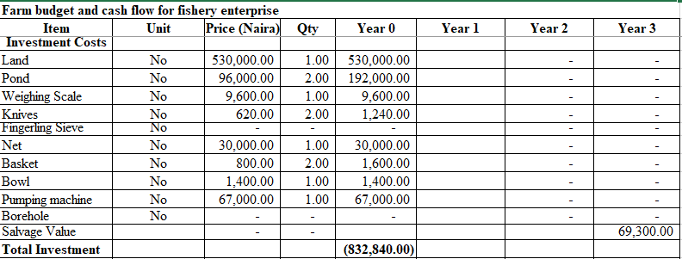
PRACTICAL SESSION
Table 4.1: Farm Budget for Fishery Enterprise

Slide 50
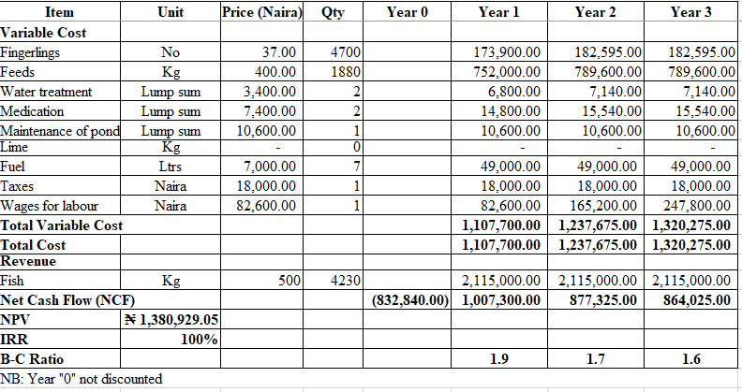
Table 4.1continues…

Slide 51
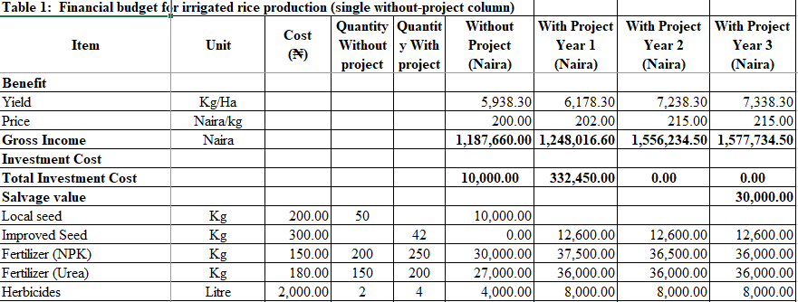
Table 4.2:Financial Budget of Irrigated Rice

Slide 52
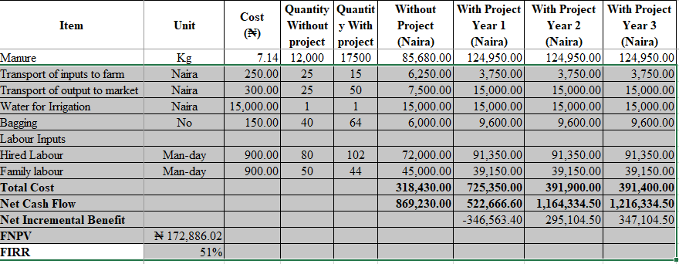
Table 4.2 continues…

Slide 53
MODULE 5 DISCOUNTED MEASURES OF PROJECT WORTH
5.0 Discounted Cash flow:
This involves the discounting of all future receipts and expenditures
Discounted cash flow reduces the various cash flows to their present value equivalent using a discount factor
It is amenable to incorporate inflation, taxation, and frequent changes in income and receipts
Discounted measures of project worth are means of measuring cash flows to allow for future time
They address the drawback of undiscounted measures by taking care of time value of money
Discounted measures in CBA comprises:
Benefit-Cost Ratio
Net Present Value
Internal Rate of Return

Slide 54
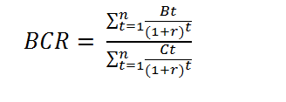
5.1Benefit-Cost Ratio
This is the ratio of discounted benefits to discounted costs as represented in Equation 8
(8)
Where: BCR = Benefit-cost ratio; B_{t} = Benefit in each project year;
C_{t} = Cost in each project year; n = Number of years; and
r = Interest or discount rate
Decision rule:
BCR > 1 Project should be undertaken
BCR = 1 Project is neither making profit nor loss
BCR < 1 Project should not be undertaken

Slide 55
5.1.1 Advantages and Disadvantages of BCR:
Advantages
Accepts all independent projects with a BCR value equal to or greater than one;
Considers the time value of money; and
Considers the cash flow stream in its entirety.
Disadvantages:
Discriminates against projects with relatively high gross returns and costs when in fact they have higher wealth-generating capacity; and
As in all discounted cash flow indicators (e.g., NPV and IRR), ranking is influenced by the discount rate.
NOTE: An independent project refers to one whose acceptance or rejection is independent of the acceptance or rejection of other projects

Slide 56
5.2 Net Present Value (NPV)
Represents the value of the discounted benefit less the discounted costs.
It is also expressed as the present worth of the incremental net benefit or cash flow
The model for NPV can be in two forms, as presented in Equations 9 & 10
$NPV=−K+\sum_{t=0}^{t}{\frac{Bt−Ct}{{(1+r)}^{t}}}$ (For the Year 0 Format) (9)
$NPV=\sum_{t=0}^{t}{\frac{Bt−Ct}{{(1+r)}^{t}}}$ (For the Year 1 Format) (10)
Where: NPV = Net Present Value; Bt = Benefits accruing in period t; Ct = Costs incurred in period t; r = Discounted or interest rate; and t = Life of the project
Decision Rule:
NPV ≥ 0 Accept project
NPV < 0 Reject project

Slide 57
5.2.1 Advantages and Disadvantages of NPV
Advantages:
Takes account of the time value of money;
Meets with the objective of wealth maximization;
NPVs for various projects can be added, for example:
NPV (A+B) = NPV(A) + NPV(B);
Considers the time value of money; and
Considers the cash flow stream in its entirety.
Disadvantages:
Employs the absolute value, hence, may not appear meaningful to investors that think in terms of the rate of return

Slide 58
5.3 Internal Rate of Return (IRR)
This is the discount rate that gives zero NPV,
Calculating IRR manually can be complicated and time consuming.
Trial and error may be used to determine the IRR however, Microsoft Excel does that efficiently.
The model for deriving the IRR is given in Equation 12 below
$IRR= R1 +\frac{(NPV1)×(R2− R1)}{(NPV1−|NPV2|)}$ (11)
Where: R1 = Lower discount rate; R2 = Higher discount rate; NPV1 = Higher Net Present Value; |NPV2| = Absolute value of Lower Net Present Value.
Note: NPV1 needs to be positive and NPV2 negative
Decision rule:
Accept any project with IRR equal to or more than the predetermined discount rate and; Reject project with IRR below the predetermined discount rate

Slide 59
5.3.1 Advantages and Disadvantages of IRR:
Advantages:
Considers the time value of money
Considers the cash flow stream in its entirety
Disadvantages:
Project cannot be confidently ranked on the basis of the IRR, as it can lead to erroneous investment choice in the case of mutually exclusive projects (though NPV criteria can be used to redress this problem); and
Ranking is influenced by the discount rate.

Slide 60
5.4 Mutually exclusive projects
Projects are considered to be mutually exclusive when they cannot be executed at the same time.
Only one project may be selected at the expense of the other.
For mutually exclusive projects, the project that maximizes net benefits is favoured.

Slide 61
5.5 Capital constraints
When there are constraints to initial capital, the choice of project is not so simple.
For example, alternative projects may all have positive net benefit
With a constraint on initial investment, the preferred approach is to use NPV (just as in the mutually exclusive projects case) (Crawford, 2019)
Ranking of the NPV enables one to select the project that maximizes net benefit.

Slide 62
5.6 Conclusions on use of NPV, IRR, B/C ratio
In CBA, the excess of total benefit over total cost is represented by the net present value (NPV) of the project.
The values of future costs and benefits used in estimating NPV are based on forecasts that cannot be known with certainty.
The IRR is the discount rate at which the NPV of a project is zero.
The decision-maker decides whether this rate of return is ‘acceptable’ or not.
Projects that have IRR greater than the recommended discount rates are regarded as acceptable
A BCR ratio greater than 1 indicates there is net benefit to the project based on present values of the costs and benefits.
The BCR must be greater than 1 for the benefits of a proposal to exceed the associated costs

Slide 64
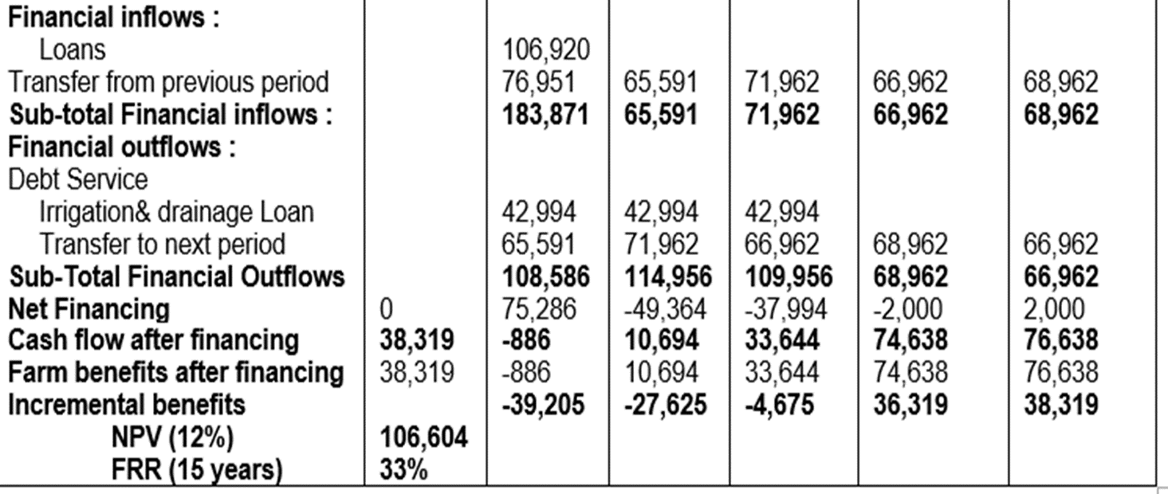

Slide 65
MODULE 6 RISK ANALYSIS IN CBA
6.1 Purpose of Sensitivity Analysis
Sensitivity analysis, also referred to as “what-if” analysis is carried out to assess the robustness of the results of analysis to changes in the basic assumptions
It assesses the impacts of uncertainty or risk by varying one or more uncertain parameters at a time
The impact these variations have on the results of an analyses is used to identify the greatest sources of uncertainty or risk

Slide 66
6.2 Types of Sensitivity Analysis
a. Partial sensitivity analysis
This is the most commonly used approach
It involves using alternative values for individual key parameters.
It is mostly used in analysis involving discount rates.

Slide 67
b. Extreme case analysis
This is carried out to determine worst- or best-case scenario
Involves combinations of assumptions about key parameters to determine the values that will reverse the sign of net benefit
Worst case analyses could be preceded by partial sensitivity analysis to determine important variables to include in the scenarios

Slide 68
c. Simulation
Here, a model that replicates the behaviour of the system is used
Simulation models generally use mathematical expressions and computers to replicate and predict a system’s behaviour
Simulation method in CBA is also referred to as risk analysis
In risk analysis, key CBA parameters are treated as random variables with known or assumed probability distributions.

Slide 69
6.3 Effects of Changing Variables
To estimate the effects of changing variables, the values of the base indicators of viability (IRR, NPV& NI) should be calculated for different values of key variables.
This is done by calculating the:
Sensitivity Indicators
Switching values

Slide 70
6.3.1 Sensitivity Indicator
A sensitivity indicator shows which variable a project is sensitive or not sensitive to.
1. Sensitivity indicator for NPV:
A sensitivity indicator towards the NPV compares percent change in NPV above the cut-off with percent change in a variable or combinations of variables
SI towards NPV is expressed as: SI = $\frac{{(NPV}_{b}{NPV}_{1})/{NPV}_{b}}{{(X}_{b}{−X}_{1}{)/X}_{b}}$ (12)
Where: Xb = Value of variable in the base case
X1 = Value of variable in the sensitivity test
NPVb = Value of NPV in the base case
NPV1 = Value of variable in the sensitivity test

Slide 71
6.3.1 Sensitivity Indicator (continues…)
2. Sensitivity indicator for IRR:
A sensitivity indicator towards IRR is given by:
SI = $\frac{{IRR}_{b}−{IRR}_{1}/{(IRR}_{b}−d)}{{(X}_{b}{−X}_{1}{)/X}_{b}}$ (13)
Where:Xb = Value of variable in the base case
X1 = Value of variable in the sensitivity test
IRRb = Value of IRR in the base case
d = Discount rate

Slide 72
6.3.2 Switching Values
Measures the extent of change for a variable which will leave the project decision unchanged.
The switching values for a variable shows by what percentage the variable would have to change for a system to breakeven.
Switching value towards the NPV is given by:
$SV= \frac{X_{b}−X_{1}}{{NPV}_{b}−{NPV}_{1}}×\frac{100×{NPV}_{b}}{X_{b}}$ (14)
Where: $X_{b}=Value of variable in base case$
$X_{1}$ = Value of variable in the sensitivity test
${NPV}_{b}$= Value of NPV in the base case
${NPV}_{1}$= Value of variable in the sensitivity test

Slide 73
6.3.2 Switching Values
Switching value towards Net Income
To calculate switching value towards Net Income, the break even point is first estimated
For example to calculate breakeven output:
BO$=\frac{(TC×QO)}{TR}$ (15)
Where :
BO= Breakeven output, TC= Total Cost, QO = Quantity of Output, TR = Total Revenue, and PO= Price of Output
Therefore:
$SV=\frac{BO}{TO}×100$

Slide 74
6.4 Steps in Carrying out sensitivity Analysis
Identify major sources of risk/uncertainty
Use different values for the identified sources of uncertainty
Analyze the sources of uncertainly that yield the highest impact on project outcome

Slide 75
MODULE 7
ECONOMIC COST-BENEFIT ANALYSIS
7.0 ECONOMIC COST-BENEFIT ANALYSIS
This refers to CBA from the society, national or global point of view.
An economic analysis takes a broader view of the profitability of the project by including externalities such as environmental and health impacts.
Assesses the benefits expected from a project and ascertains whether the costs to achieve these benefits are justified to the economy.

Slide 76
7.1Assumptions of economic cost benefit analysis
Takes existing ownership rights to resources as given.
All constraints to free trade of resources and output are assumed away
No monopoly effects exist in the economy and Government interference was limited to ensuring free competitive enterprise
However, the above situation is not always or rather never the case, hence the need to adjust for distortions.

Slide 77
7.2 Differences between Financial and Economic CBA Analyses
 | Financial CBA Analysis | Economic CBA Analysis
Purpose | Efficiency of private investment | Efficiency of public investment
Focus | Net returns to private group /individual | Net returns to society-at-large
Benefits | Market goods and services | Market, non-market goods and services, and non-use values
Prices | Market or administered | Market, administered or shadow (adjusted or assigned) prices

Slide 78
7.2 Differences between Financial and Economic CBA Analyses (continues)
 | Financial CBA Analysis | Economic CBA Analysis
Taxes | Cost to the firm or individual | Typically treated as a transfer payment (cost to consumer offset by benefit to government); may be administrative costs
Subsidies | Revenue to the firm or individual | Transfer payment: benefit to producers & consumers offset by cost to taxpayers.
Discount rate | Private opportunity cost of capital | Social Discount Rate (assigned by the agency)
Distribution of Benefits (Equity) | Not an issue | Not a principal concern of CBA, but can be an issue for separate analysis

Slide 79
7.3 Financial versus Economic prices (supply and demand prices)
Costs in economic analysis are valued as
opportunity cost
welfare Losses
Benefits on the other hand are valued as
welfare gains
resource savings

Slide 80
7.4 Conversion of financial to economic benefits/costs
Financial prices of costs and benefits must be adjusted to allow for:
effects of government intervention ( such as taxes, subsidies, controls, and quotas);
opportunity costs of resource use;
market distortions (trade taxes and controls, labour market distortions); and
externalities (mostly environmental)

Slide 81
7.4 Conversion of financial to economic prices
To convert financial to economic prices of goods and services,
The first step is to group all goods and services into tradable and non-tradable.
Goods/Commodities
Costs(Inputs) Benefits (Outputs)
Tradable Inputs Tradable
Non-tradable (domestic factors) Non-tradable
Transfers Transfers
Tradable + Non-tradable Tradable + Non-tradable

Slide 82
7.4 Conversion of financial to economic prices (continues)
To convert financial to economic prices, the following methods may be used:
1. Shadow Pricing
Conversion Factor (CF) is estimated using Equation 16
CF = $\frac{EP}{FP}$ (16)
Where: EP=economic price,
FP= financial price

Slide 83
2. Foreign exchange premium
Foreign exchange premium refers to the sum above the nominal foreign exchange
To calculate foreign exchange premium (FXP), the following formula detailed in Equations 17 & 18 are used:
$\left(1+FXP\right)=\frac{M\left(1+tm\right)+X(1+tx)}{(M+X)}$ (17)
Therefore,
$SER=OER×(1+FXP)$ (18)
Where:
M = CIF value of imports (in domestic currency), tm = average ad valorem import tariff rate, X = FOB value of exports (in domestic currency), tx = average ad valorem export tax rate, SER = Shadow Exchange Rate; and OER = Official Exchange Rate

Slide 84
3. Standard Conversion Factor (SCF)
The Standard Conversion Factor is estimated as Equations 19 & 20:
$SCF=\frac{1}{(1+FXP)}$ (19)
$SCF=\frac{OER}{SER}$ (20)
NOTE:
SCF and SER are used alternatively in correcting for domestic currency overvaluation.
In the SCF approach, only the nontraded goods are adjusted, whereas the SER approach adjusts only the traded goods.

Slide 85
7.5 Valuation of (internationally) traded goods
In calculating social prices of tradable goods and services, the following categorizations of tradable goods and services are made
exportable domestic output,
domestic input or output as (current or potential) import substitute,
exportable input in domestic production processes,
A frequently used starting point for estimating social prices for internationally tradable goods is their parity prices.
Parity price refers to the price of the good at the project level that is equivalent to its import or export price in the world market
The steps involved in estimating the economic costs of tradable inputs and outputs are expressed in Table 7.1

Slide 86
Table 7.1: Computation of parity price of tradable inputs
Item | Acronym | Currency
CIF Price in foreign currency | A | Foreign currency
Official Exchange Rate (OER) | B | Domestic currency
Border Price (CIF price in local currency) | C=A*B | Domestic currency
Import tariff (ad valorem percent) | D | Domestic currency
Unit import tariff | E | Domestic currency
Total import tariff | F=C*D+E | Domestic currency
Transport Cost from border to domestic market | G | Domestic currency
Handling Cost from border to domestic market | H | Domestic currency
Storage Cost from border to domestic market | I | Domestic currency
Parity Price at market level (PPML) | J=C+F+G+H+I | Domestic currency
Transport Cost from firm/farm to domestic market | K | Domestic currency
Handling Cost from firm/farm to domestic market | L | Domestic currency
Storage Cost from firm/farm to domestic market | M | Domestic currency
Parity Price at production level (PPPL) | N=J-(K+L+M) | Domestic currency

Slide 87
7.6 Valuation of non-traded goods (Labour and Land)
The services provided by domestic factors of production (labour, capital, and land) do not have world prices because the markets for these services are domestic
The starting point for estimating social prices for non-tradable goods and domestic factors are prevailing domestic market prices or the costs of producing them
For mobile factors (factors that can move from agriculture to other sectors of the economy), prices are usually determined by aggregate supply and demand forces.

Slide 88
7.6 Valuation of non-traded goods (continues…)
Since alternative uses are available throughout the economy, the social values of capital and labour can be determined at a national level and not solely within the agricultural sector
Most developing countries, including Nigeria, implement policies that distort the economy mainly to protect local producers
Example of such policies include price ceilings and minimum wages
To adjust for these distortions, the prices of non-traded goods and services will be weighted with the standard conversion factor (SCF)

Slide 89
7.7 Externalities and indirect effects in Economic Analysis
Externalities refer to the effect of the project on people outside the project area
Examples include pollution of air, and water, underground water shortage because of dam project
Externalities could be positive or negative
They can be valued using market valuation where feasible, damage function and/or willingness to pay

Slide 90
7.7 Externalities and indirect effects (continues…)
Where significant, they should be identified, quantified, and included in the project cost
Assume principle of materiality if externality is insignificant
For rice and fish enterprises for instance, externalities can include:
Carbon emission
Water pollution arising from discharge of reservoir water and waste
For valuation of carbon for instance, the FAO Ex-ante Carbon Balance Tool (EX-ACT) can be used to estimate changes in carbon stock as a result of the project.

Slide 91
Example; Estimating the economic budget for rice production
To calculate the economic price of output (rice), the following estimates may be used
Table 7.2: Economic cost of transportation using Shadow Exchange Rate (SER) Approach
Exchange rate overvaluation (Year 2021) | 18.50 % = 1.185
Naira - US$ (OER) | 410.4
SER=OER*1.185 | 486.32
SCF = OER/SER | 0.843882
Unit cost ₦/Km | 200
Tradable portion of transport | 67% (Adler, 1987)
Tradable:
0.67*200* 1.185 | 158.79
Non-tradable:
0.33*200 | 66
Total economic cost | 224.79
Conversion Factor for Transportation | 1.124

Slide 92
Table 7.3: Economic cost of transportation using Standard Conversion Factor (SCF) Approach
Unit cost ₦/Km | 200
SCF = OER/SER | 0.843882
Tradable portion of transport | 67% (Adler, 1987)
Tradable:
0.67*200 | 134
Non-tradable:
.33*200*0.843882 | 55.7
Total economic cost | 189.7
Conversion Factor for Transportation | 0.9485

Slide 93
Table 7.3: Additional Data on Transportation
Intra-State Transportation
Local transport rate N400 @ 80Kg
Average distance scheme to local market | 40 Km
1km | N10
Inter-State Transportation
N2000 @ 80Kg
Average distance Lagos- Sokoto | 1,090 Km
1Km | N1.83

Slide 94
Table 7.4: Economic cost of rice using the Shadow Exchange Rate (SER) approach
S/N | Item | Unit | Computation | Value
A | Rice (FOB Bangkok) | $/MT |  | 392.00
B | Freight and Insurance | $/MT | 8 percent of A | 31.36
C | Border price (CIF Apapa, Lagos) | $/MT | A+B | 423.36
D | SER = (OER*18.5% overvaluation) | N/S | 410.4*1.185 | 486.00
E | CIF in NGN = CIF*SER | ₦/MT | C*D | 205,752.96
F | Port Handling and Clearance Charges | ₦/MT | 10% of E | 20,575.30
G | Distance from Port to Goronyo | Km | 1,090.00
H | Mileage rate (Port - Goronyo) | ₦/Km | 1.83
I | Conversion factor for transport |  | 1.124
J | Transportation Cost | ₦/MT | G*H*I | 2,242.04
K | Price at main market | ₦/MT | E+F+J | 228,570.30

Slide 95
L | Average distance to local market | Km | 40
M | Mileage rate to local market | ₦/MT/Km | 10
N | Transport cost to local market | ₦/MT | (L*M)* 1.124 | 449.60
O | Price of milled rice at local market | ₦/MT | K+N | 229,019.90
P | Weight conversion factor |  | 0.001
Q | Price of milled rice | ₦/Kg | O*P | 229.02
R | Milling rate (paddy to rice) |  | 0.67 | 0.67
S | Paddy equivalent cost | ₦/Kg | Q*R | 153.44
T | Milling cost of paddy per Kg | ₦/Kg |  | 25.00
U | Price of paddy/Kg | ₦/Kg | Q*R-T | 128.44
V | Distribution cost to farm | ₦/Kg |  | 4.34
W | Conversion factor for transport |  | 1.124 | 4.88
X | Farm gate price/Kg | ₦/Kg | U+W | 133.32
Y | Parity Price of 80kg of paddy |  | X*80 | 10,665.72

Slide 96
Table 7.5: Economic cost of rice using the Standard Conversion Factor (SCF) approach
 | Item | Unit | Computation | Value
A | Rice (FOB Bangkok) | $/MT |  | 392.00
B | Freight and Insurance | $/MT | 8 percent of A | 31.36
C | Border price (CIF Apapa, Lagos) | $/MT | A+B | 423.36
D | OER | ₦/S | 410.4
E | CIF in NGN = CIF*OER | ₦/MT | C*D | 173,746.94
F | Port Handling and Clarance Charges | ₦/MT | 10% of E | 17,374.69
G | Distance from Port to Goronyo | Km | 1,090.00
H | Mileage rate (Port - Goronyo) | ₦/Km | 1.83
I | Conversion factor for transport |  | 0.948
J | Transportation Cost | ₦/MT | G*H*I | 1,890.98
K | Price at main market | ₦/MT | E+F+J | 193,012.61

Slide 97
L | Average distance to local market | Km | 40
M | Mileage rate to local market | ₦/MT/Km | 10
N | Transport cost to local market | ₦/MT | (L*M)*0.948 | 379.20
O | Price of milled rice at local market | ₦/MT | K+N | 193,391.81
P | Weight conversion factor |  | 0.001
Q | Price of milled rice | ₦/Kg | O*P | 193.39
R | Milling rate (paddy to rice) |  | 0.67
S | Paddy equivalent cost | ₦/Kg | Q*R | 129.57
T | Milling cost of paddy per Kg | ₦/Kg |  | 25.00
U | Price of paddy/Kg | ₦/Kg | Q*R-T | 104.57
V | Distribution cost to farm | ₦/Kg |  | 4.34
W | Conversion factor for transport |  | 0.948 | 4.11
X | Farm gate price/Kg | ₦/Kg | U+W | 108.69
Y | Parity Price of 80kg of paddy |  | X*80 | 8,694.95

Slide 98
Table 7.6: Adjustment of price distortion in wage rate
Item description | Estimate
Number of months in the agricultural calendar (A) | 12
Number of months in the year labour is employed (B) | 5
Weighting factor (C) = (B/A) | 0.42
Standard conversion factor (SCF) =OER/SER (D) | 0.84
Weighting factor for converting financial to economic wage rate (E) = C*D | 0.35
Given Financial wage rate (F) | ₦1,000
Economic wage rate = 1,000 x 0.35 | ₦350

Slide 99
MODULE 8 Applications of CBA to policy analysis
8.0 APPLICATIONS OF CBA TO POLICY ANALYSIS
CBA allows the assessment of economic efficiency of proposed public policies through the systematic forecasting of social costs and social benefits.
Valuing effects and aggregating across all members of society yields the net social benefits of the policy.
A policy with positive net social benefits is viewed as economically efficient

Slide 100
8.1 Types and causes of Divergences in Prices
What are divergences?
8.1.1 Divergence due to market failure
Market failure refers to a situation where market operations lead to inefficient allocation of products/factors. Here, the market fails to generate competitive prices that reflect social opportunity cost due to:
Monopoly or monopsony
Negative externalities (costs for which the imposer cannot be charged)
Positive externalities (benefits for which the provider cannot receive compensation)
Factor market imperfections (inadequate development of institutions to provide competitive services and full information).

Slide 101
8.1.2 Divergence due to distorting government policy
Distorting policies
Policies prevent efficient allocation of resources to further non-efficiency objectives such as equity or security.
A tariff on rice imports, for example, may lead to increase in incomes of domestic farmers and domestic rice production.
Tariff may also give rise to efficiency losses if imports were cheaper than the costs of domestic resources used to produce the additional rice.
Note:
Divergences could be eliminated, in principle, if the government were able to implement efficient policies that offset market failures or to override non-efficiency objectives and remove distorting policies (Pearson et al., 2003).

Slide 102
8.2 The Policy Analysis Matrix
The PAM is an analytical framework for measuring:
the impact of policy on competitiveness and farm-level profits;
the influence of investment policy on economic efficiency and comparative advantage; and
the effects of agricultural research policy on changing technologies.
PAM provides a complete and consistent approach to determining all policy influences on costs and returns of agricultural production (Monke and Pearson, 1989).

Slide 103
8.3 PAM Results
The results obtained from the PAM is utilized in the identification of:
competitive producers under existing policies;
how profits change due to changes in policies based on the type of commodities grown;
producers’ technological level, and the agro-ecological zones in which their farms are situated;
commodity production systems that currently have strong or weak comparative advantage; and
the most productive guidelines for basic and applied research to raise crop yields, reduce social costs and, consequently, increase social profits.

Slide 104
8.4 Framework of the Policy Analysis Matrix (PAM)
Each PAM contains two cost columns, one for tradable inputs and the other for domestic factors
Costs are further differentiated into four categories; tradable inputs, domestic factors, transfers (taxes or subsidies that are set aside) and inputs made of tradable and non-tradable components
Inputs made of tradable and non-tradable components are further broken down so that ultimately all production costs are classified as tradable inputs, domestic factors, or Transfers

Slide 105
Table 8.1: Framework of the Policy Analysis Matrix (PAM)
Parameters | Revenues | Tradable input costs | Domestic Factors costs | Profits
Private Prices | A | B | C | D= A – B−C
Social Prices | E | F | G | H= E - F – G
Transfers | I= A – E | J= F – B | K= G – C | L=I+J+K = D−H
Where:
A = Private revenues; B = Private input costs; C = Private factor costs; D = Private profits = A – B – C; E = Social revenues; F = Social input costs; G = Social factor costs; H = Social profits = E - F – G; I = Output divergences = A – E; J = 1nput divergences = F – B; K = Factor divergences = G – C; L = Net divergences= I + J + K.

Slide 106
8.5 Uses of the Policy Analysis Matrix
The first row of the PAM measures the competitiveness of a system.
The second-row measures comparative advantage.
The third row measures the divergences between the financial and social values and hence, the magnitude of incentives or disincentives for agricultural production.

Slide 107
Practical Session:
Using irrigated rice production system as an example, the financial and economic budgets were derived using the SCF approach.
As earlier estimated, conversion factor for transport was 0.948
SCF=OER/SER = 0.844,
OER = 410.4, and
SER = 486.32

Slide 108
Table 8.2: Economic and Financial Budget of Irrigated rice per hectare
Variables | Unit | Financial Cost | Economic Costs | Quantity | Financial Value | Economic Value
Revenue | N/Kg/Ha
yield | Kg | 215.00 | 108.69 | 7,138.30 | 1,534,734.50 | 775,839.24
Tradable Inputs
Seed (Improved) | Kg | 300.00 | 108.69 | 42 | 12,600.00 | 4,564.85
Fertilizer (NPK) | Kg | 150.00 | 216.22 | 250 | 37,500.00 | 54,054.12
Fertilizer (urea) | Kg | 180.00 | 225.43 | 200 | 36,000.00 | 45,086.26
Transport of inputs to farm | Naira | 2.50 | 2.37 | 135 | 337.50 | 319.95
Transport of output to market | Naira | 6.25 | 5.93 | 1,920 | 12,000.00 | 11,376.00
Sub Total |  |  |  |  | 98,437.50 | 115,401.18
Domestic Factors
Herbicides | Litre | 2,000.00 | 1,688.00 | 4 | 8,000.00 | 6,752.00
Manure | Kg | 7.14 | 6.03 | 17,500 | 124,950.00 | 105,457.80
Water for Irrigation | Naira | 15,000.00 | 12,660.00 | 1 | 15,000.00 | 12,660.00
Bagging | No | 150.00 | 126.60 | 64 | 9,600.00 | 8,102.40

Slide 109
Table 8.2 continues…
Variables | Unit | Financial Cost | Economic Costs | Quantity | Financial Value | Economic Value
Hoe | Nos | 1,000.00 | 844.00 | 3.00 | 3,000.00 | 2,532.00
Cutlasses | Nos | 1,200.00 | 1,012.80 | 3.00 | 3,600.00 | 3,038.40
Knap sprayer | Nos | 8,000.00 | 6,752.00 | 3.00 | 24,000.00 | 20,256.00
Sickle | Nos | 250.00 | 211.00 | 5.00 | 1,250.00 | 1,055.00
Rake | Nos | 600.00 | 506.40 | 1.00 | 600.00 | 506.40
Land rent | Ha | 30,000.00 | 25,320.00 | 1.00 | 30,000.00 | 25,320.00
Hired labour | Man-day | 900.00 | 759.60 | 101.50 | 91,350.00 | 77,099.40
Family labour | Man-day | 900.00 | 759.60 | 43.50 | 39,150.00 | 33,042.60
Subtotal |  |  |  |  | 350,500.00 | 295,822.00
Total cost |  |  |  |  | 448,937.50 | 411,223.18
Profit |  |  |  |  | 1,085,797.00 | 364,616.06

Slide 110
Table 8.3: The Policy Analysis Matrix (PAM)
Parameters | Revenues | Tradable input costs | Domestic Factors costs | Profits
Private Prices | 1,534,734.50 | 98,437.50 | 350,500.00 | 1,085,797.00
Social Prices | 775,839.24 | 115,401.18 | 295,822.00 | 364,616.06
Transfers | 758,895.26 | 16,963.68 | -54,678.00 | 721,180.94

Slide 111
8.5 Interpretation
The results of the PAM analysis can be interpreted as follows:
The first row of the PAM gives a positive profit value which implies the production system is financially competitive.
The second-row also gives a positive profit value, indicating there is comparative advantage in irrigated rice production
In the third row, the positive divergence in tradable input implies the system is protected while the negative divergence in domestic factors implies the system is taxed. However, a positive net implies that overall, the system is protected by Government policies.

Slide 112
REFRENCES
Belli, J.A., Anderson, J. Dixon, J. & Tan, J. (1998). Handbook on economic analysis of investment operations. Operational Core Services Network Learning and Leadership Center.
Boardman, A.A., Greenberg, D.H., Vining, A.R. & Weimer, D.L. (2018). Cost-benefit analysis. Concepts and practice. Cambridge University Press, United Kingdom.
Brown, M.L. (1982). Farm budgets. From farm income analysis to agricultural project analysis. World Bank, The John Hopkins University Press, Baltimore and London.
Campbell, H.F. & Brown, R.P.C. (2016). Cost-benefit analysis. Financial and economic appraisal using spreadsheets. Routledge, New York.
Crawford, E. (2019). Selected handouts, Packets Nos. 1&2. AFRE 865-Agricultural benefit-cost analysis. Spring 2019. Department of Agricultural, Food, and Resource Economics, Michigan State University.
Gittinger, J.P. (1984). Economic analysis of agricultural projects. Economic Development Institute. The World Bank.
Monke, E.A. & Pearson, S.R. (1989). The policy analysis matrix for agricultural development, Ithaca N.Y. Cornell University Press.
National Programme for Food Security, (2005). Expansion Phase Project. July, 2007- June, 2012.
Robinson, L. A., & Hammitt, J. K. (2013). Skills of the trade: valuing health risk reductions in benefit-cost analysis. Journal of Benefit-Cost Analysis, Cambridge University Press, Vol. 4(1),107-130. https://ideas.repec.org/a/cup/jbcoan/v4y2013i.html

Slide 113
THANK YOU FOR LISTENING!

